Slide 1
Independence of the Dutch East Indies
By: Robin Wacanno, Piet Gotlieb and Henk Gotlieb
WC3X

Slide 2
Table of Contents
Colonisation
Portuguese
V.O.C
British
Dutch
Nationalist Movement
Japan takes over Indonesia
Royal Netherlands East Indies Army
“Jappen Kampen”
Death Railway
Japan surrenders
Famine
“Politionele acties”
Dutch Influence
Video

Slide 3
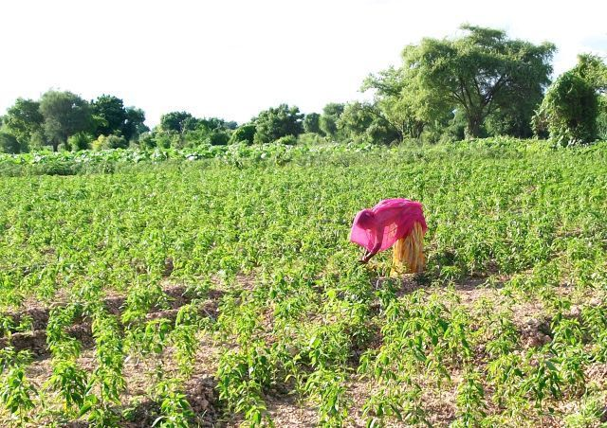
Colonisation
Waves of Europeans
Resources
‘Spice islands’
Sea lane position

Slide 4
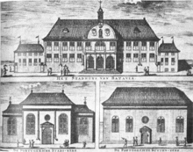
Portuguese
1512 – Malacca
Island by island
Value in spices
Catholic influence
Timor until 1975

Slide 5

V.O.C
Dutch East India Company
Monopoly in 1602
1619 Batavia
Portuguese aspiration but better tactics
1800 Bankruptcy

Slide 6
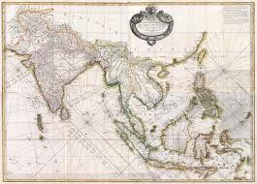
British
Thomas Stamford Raffles
1800 - 1816

Slide 7
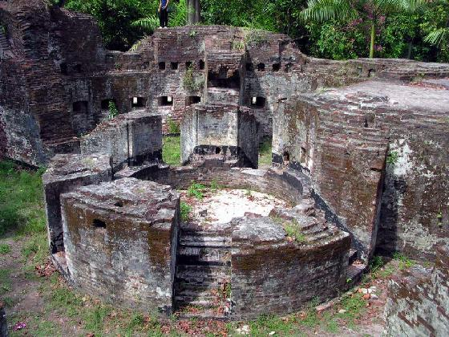
Dutch
1816
Java war 1825-1830
1830 Forced Labour but they did get something
1870
1901 ethical system- education etc.
Racial system
1920 foreign easteners
Infrastructure

Slide 8
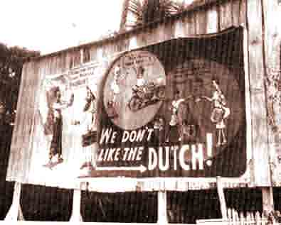
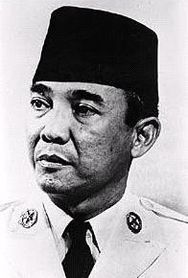
Nationalist movement
1908 - Budi Utomo
Repressive Measures
Soekarno
1901 – 1970
Study in Holland
First president of indonesia

Slide 9
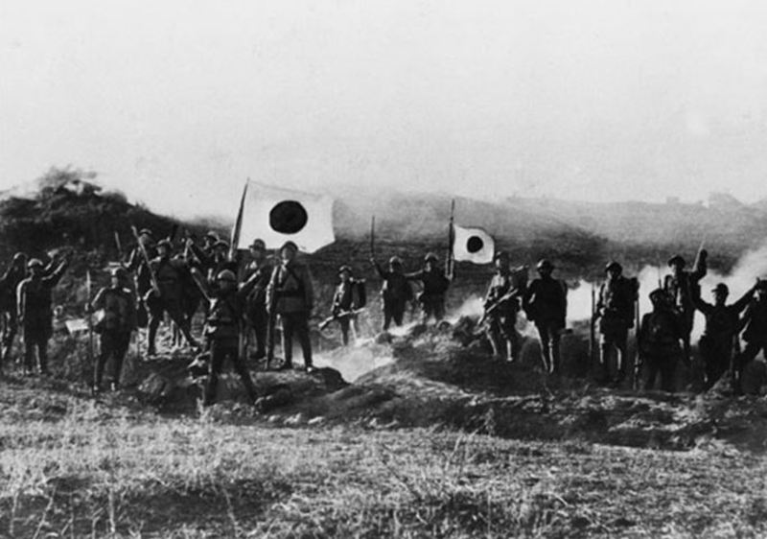
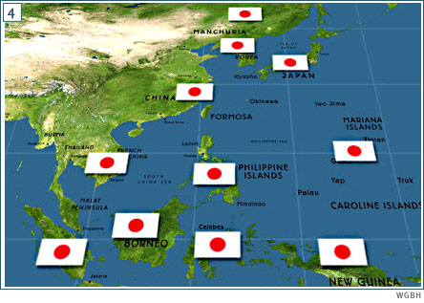
Japan takes over Indonesia
Indonesians initially happy with the Japanese
Nationalists support the Japanese

Slide 10
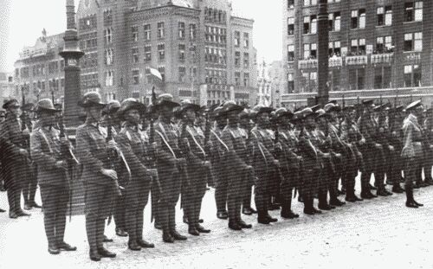
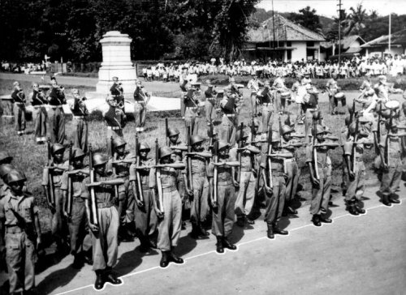
Royal Netherlands East Indies Army

Slide 11
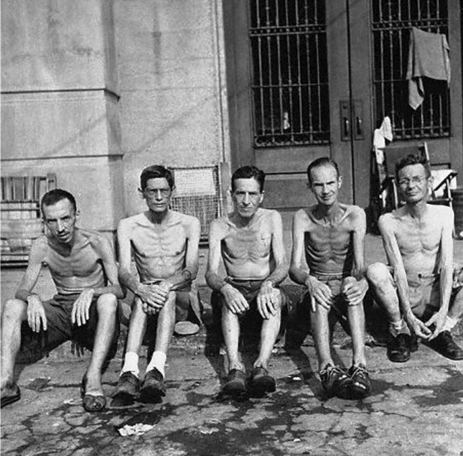
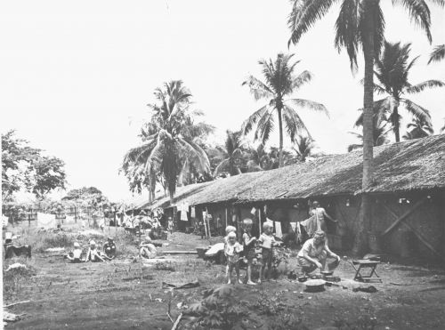
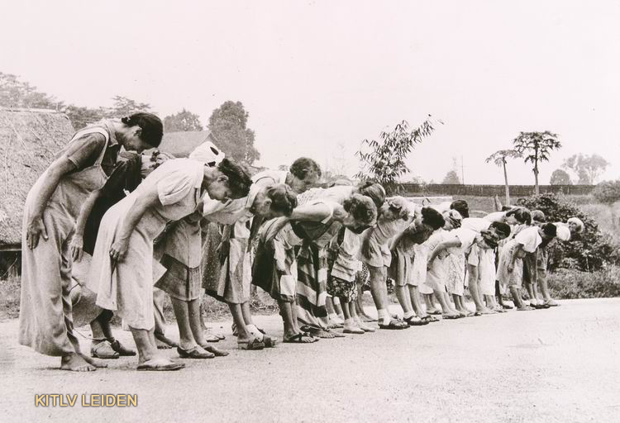
“Jappen kampen”

Slide 12
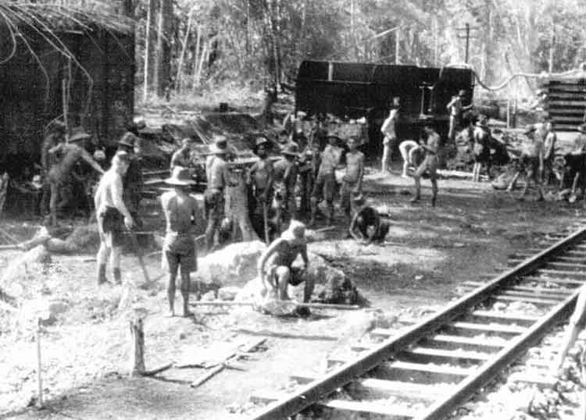
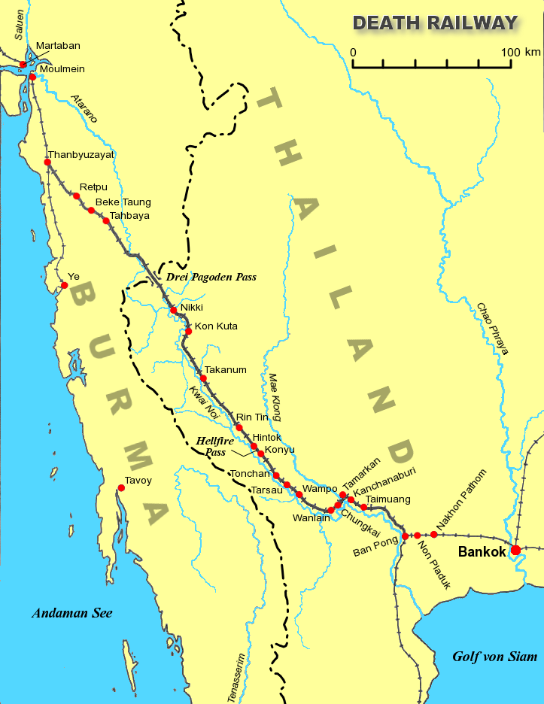
Death railway

Slide 13
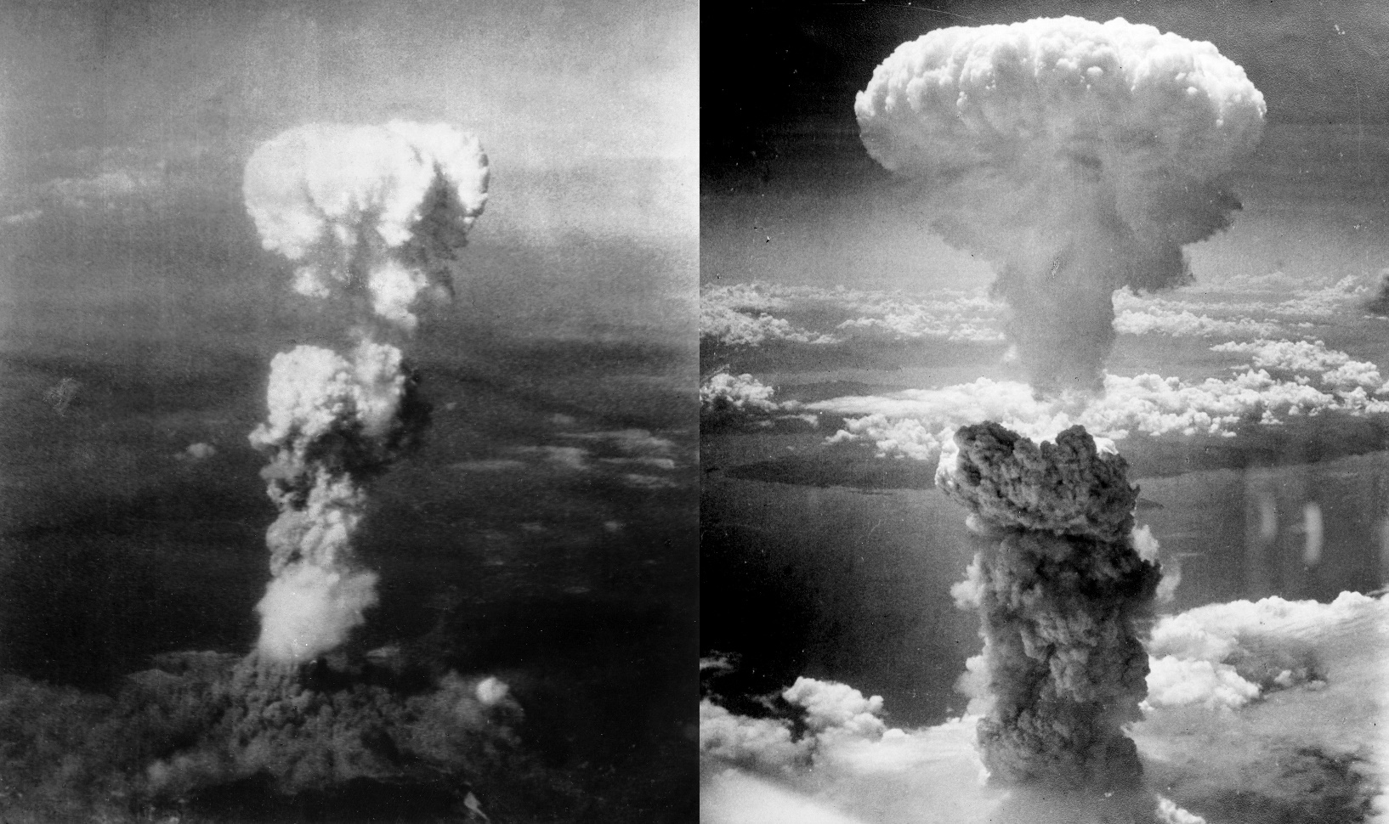
Japan surrenders
Amerika drops the atomic bombs
WWII ends in Asia

Slide 14
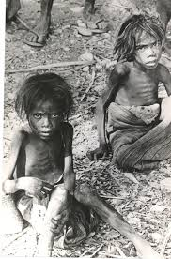
Famine in indonesia
Poverty and famine
No documents
2.5-4 million deaths
Capacity of food production
Global export
Stealing, management(rice species), forced labour, corruption and inflation
Drops in food production

Slide 15
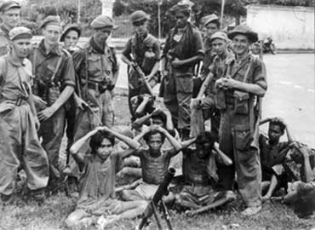
“politionele acties”
Soekarno and Hatta
1945-1949
Indonesian war of independence
Guerilla war
British
1946 the Dutch involved
Dutch military attempts
25 July to 5 August 1947
19 December 1948 to 5 January 1949
1962 Dutch New Guinea

Slide 16

Dutch influence
Hier spreekt men Nederlandsch.
Infrastructure
Architecture
Art-deco

Slide 17

Video
https://www.youtube.com/watch?v=RBugZPwWGEM

Slide 18
The End

