Slide 1
The Vietnam War
by Oscar Schouten and Sam van Kampen

Slide 2
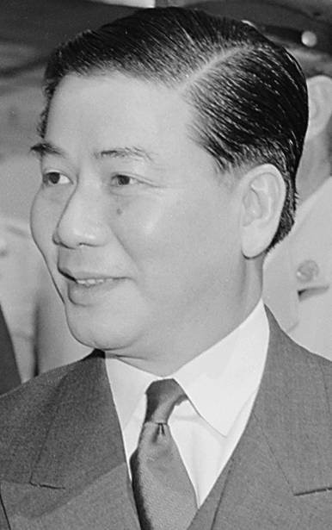
Ngô Đình Diệm
1955-1963
President Ngô Đình Diệm
  Roman Catholic
  Complete Idiot
  Fervently anti-communist
  Nepotist and Autocrat
1955 “Denounce the Communists”
1956 Death penalty against
communist activities
1957 Visit to the United States

Slide 3
The Diệm Era
1954-1957 Dissidence in the countryside
1957-1959 Incidents of violence increased
1960 National Liberation Front created
Inept South Vietnamese army
  Poor leadership, corruption, political promotions
  Battle of Ap Bac in January 1963
Discontent with policies
  Buddhist flag
  Mass protests
Discussion of regime change in America
Diem murdered in 1963 by the United States government.

Slide 4
The Kennedy Era
“Diem needs to defeat the guerillas on his own”
Against sending combat troops to Vietnam
Lyndon B. Johnson calls Diem the “Winston Churchill of Asia”.

Slide 5
After the coup
Chaos
  North Vietnam supports the Vietcong
  Extreme political instability
  Governments regarded as American puppets

Slide 6
The Johnson Era
Sends more troops, counteracting Kennedy’s plans
“Rolling Thunder”
Contest of Morale and Attrition
Tet Offensive, tipping point in the war

Slide 7
The Nixon Era
Nixon Doctrine, “Vietnamization”
Death of Ho Chi Minh
Withdrawal of all ground troops by 1972
Operation Linebacker II
1973 Paris Peace Accord

Slide 8
Opposition to the War
Credibility Gap
Anti-war protesting
Kent State University

Slide 9
The End

