Slide 1

Computer Architecture
Lab - Week 3 Review
ing. Edwin Steffens
Practical lecturer – Informatics Institute

Slide 2
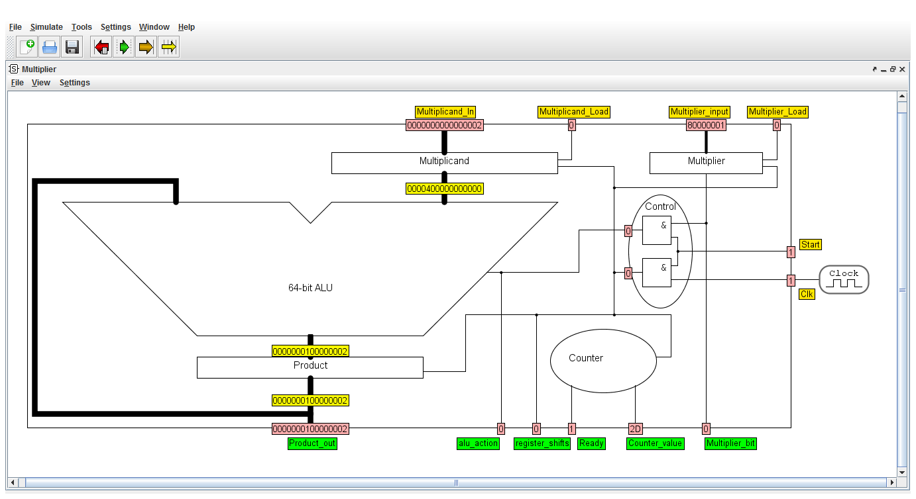
Multiplier

Slide 3

Review Lab exercises – week 3
Math – By Hand - Assignment 1
binary multiplication 0x59 and 0x14
1011001
0010100
---------
101100100
10110010000
-------------
11011110100
binary division
35 /8
1000/100011\100.011
-1000
--------
0001100
1000
-----------

Slide 4
Review Lab exercises – week 3
Assignment 1
Floating point notation
Number: -214.625
IEEE FP Single precision |  | 32 bits
Sign | Exponent (8) | Fraction (23)
1 | 1000 0110 | 1010 1101 0100 0000 0000 000
IEEE FP Double precision |  | 64 bits
Sign | Exponent (11) | Fraction
1 | 100 0000 0110 | 1010110101000000000000000000000000000000000000000000

Slide 5
Review Lab exercises – week 3
Software solution
SingleCycle program using MULT instruction
ORI $1, $0, 0x3 # Load 3 in reg 1
ORI $2, $0, 0x4 # Load 4 in reg 2
MULT $2, $1 # Multiply 4 and 3
MFLO $3 # Retrieve the result
Compare the CPI of both programs
CPI = 1

Slide 6
Review Lab exercises – week 3
Hardware solution
What can you say about the CPI on one multiply instruction?
CPI > 1
What about the control lines and datalines?
5 input control lines. Extend the databus. 1 output line ie the ready bit.

Slide 7
Review Lab exercises – week 3
Hardware solution
What is the effect on the Cycle time of the architecture extension?
Describe how to produce a control bit to select the multiplier.
Assign an address to the multiplier, Decode the address lines to select
Same datapath to the register file, How to solve this ?
Multiplexer

Slide 8
Review Lab exercises – week 3
multiplication and a shift
Rewrite the following statements
x >> n and x << n (0 < n < 32)
to only contain
multiplication, addition, subtraction and/or division, modulo, floor, ceil and power.
Solution
x >> n = floor( x / 2 ^n )
x << n = x * 2 ^n

Slide 9
Review Lab exercises – week 3
Single Cycle pipe-line
Addition.wasm
Result = totally useless
Output of registers too late
Addition-incorrect.wasm
Correct result from ALU but not written in register
Solution: add two NOPS delay

Slide 10
Review Lab exercises – week 3
.data MyRegisters: REGISTERS
0: WORD zero 0
1: WORD temp 0
# Input
16: WORD s0 123456789
# Magic number, calculated by hackersdelight.org/magic.htm
23: WORD s7 0xCCCCCCCD
# (s1) = (s0) / 10
# Algorithm based on https://cboard.cprogramming.com/c-programming/128093-there-standard-function-12.html#post958170
# (s1,_) = (s0) * magic(s7) // Perform magic multiplication
MULT $s0, $s7
MFHI $s1
# (t0) >> 3 // Perform magic shift
SRL $s1, $s1, 3

Slide 11
Review Lab exercises – week 3
Questions ?

