Slide 1
Grammatical relations in qiang
By Stijn Marsman
10/01/2020

Slide 2
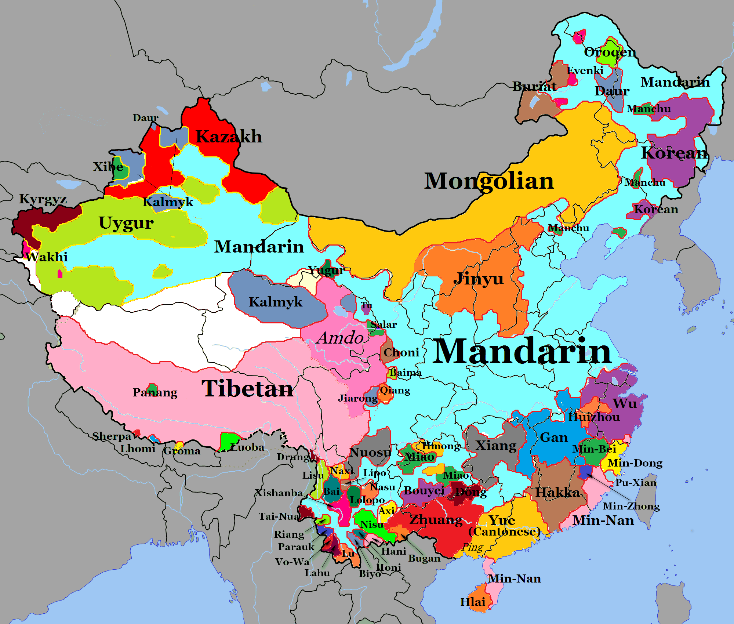
PReface
LaPolla and Huang (2003)
Several unique glossing terms:
DIR: directional prefix
CSM: change of state marker
U: bound non-actor marker

Slide 3
QIANG PRONOMINAL NOUN PHRASES
Identical cases and case markers as nouns (LaPolla & Huang, 2003, p. 51)
No inherent morphological differences semantic roles
Example sentences including pronominal heads
Grammatical relations for nouns and pronouns will be identical
Will be equated with nominal noun phrases

Slide 4
QIANG (PRO)NOMINAL NOUN PHRASES: intransitive
Semantics/pragmatics expressed through (LaPolla & Huang, 2003, p. 71):
Word order
Postpositions
Two semantic roles: agent (actor/experiencer) & patient (undergoer)
Semantive marker –wu for agentive arguments
Semantive marker –da (dative case ending) for patientive arguments
Disallowed in intransitive clauses
Clause-initial topic position → single argument, before the verb

Slide 5
QIANG (PRO)NOMINAL NOUN PHRASES: intransitive
EXAMPLEs (1), (2) and (3)
(Lapolla & huang, 2003, p. 75, p. 120)
Clues so far
(1) Agentive intransitive clause with pronominal head:
the: thə-ʁɑ ʁlu
3SG water-LOC swim
‘’He is swimming in the river.’’
(2) Agentive intransitive clause with nominal head:
ʐɑwɑ ɦo-ɣlu
stone DIR-roll
‘’The stone rolled down’’.
No marking on the or S_{a} or S_{p}
No semantic markers
Example (1) includes a locational postposition
(3) Non-agentive intransitive clause:
khuɑʁl-le: die-ʂe
puppy-DEF-CLF DIR-die
‘’The puppy died.’’

Slide 6
QIANG (PRO)NOMINAL NOUN PHRASES: intransitive
EXAMPLEs (2) and (4)
(Lapolla & huang, 2003, p. 77, p. 120)
Case Solved: Neutralization?
(2) Clause with transitive verb
ʐɑwɑ ɦo-ɣlu
stone DIR-roll
‘’The stone rolled down’’.
(4) Clause with transitive verb:
qɑ khumtsi topu-ɑ
1SG Khumtsi like-1SG
‘’I like Khumtsi.’’
No marking on the or S_{a} or S_{p}, see example (1)
No marking on the A or P either, see example (2)
Actor-(Recipient/Goal)-Undergoer-Verb
(Lapolla & Huang, 2003, p. 76)

Slide 7
Bibliography

