Slide 1
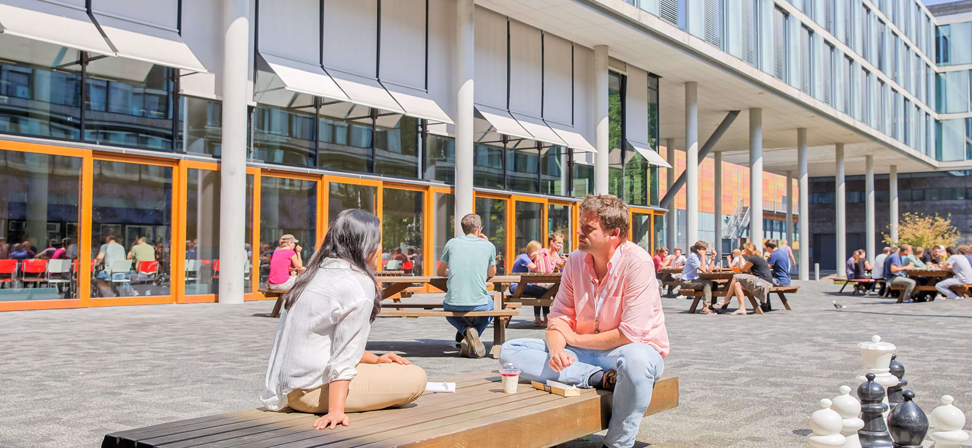
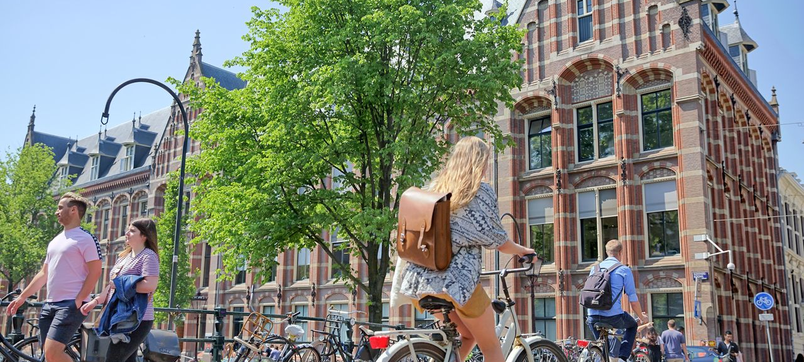
University of Amsterdam
Netherlands’s largest university
Widest range of programmes
30,000 students
6,000 staff members
3,000 PhD candidates
Seven faculties
Culture of curiosity
Blended Learning @
TLC Science
Notes:
General tips:
-Introduce yourself, present the human behind this presentation (depending on context: eg by your career and/or some private facts)
-Make the presentation interactive: ask what people already know about the Faculty, or what their connection is ...

Slide 2
Blended learning, doorlopend vanaf Blend it & Share it
Zichtbare Leerlijnen, Zichtbare onderwijsvormen en toetsing
https://tlc.uva.nl/en/article/visible-learning-trajectories-program-a-new-step-in-educational-innovation/?faculty=55
Sowiso statistiek en wiskunde
https://uva.sowiso.nl/courses/home/en
https://tlc.uva.nl/en/article/sowiso-statistics/?faculty=53
LabBuddy
https://tlc.uva.nl/en/article-category/toolbox/?faculty=53

Slide 3
Projecten
Zichtbare onderwijsvormen en toetsing (TLC Science)
https://tlc.uva.nl/en/article/visible-teaching-activities-and-assessment-project/?faculty=53
FeedbackGO (SURF project)
https://www.feedbackgo.nl/
IguideME (Comenius Teaching Fellow)
https://tlc.uva.nl/en/article/iguideme/?faculty=53

Slide 4
EU Projecten
STEM-CPD@EUni (docentprofessionalisering bottom up)
https://tlc.uva.nl/en/article/stem-cpdeuni/?faculty=53
STEAM Inc.
https://tlc.uva.nl/en/article/steam-inc/?faculty=53
VISION (bots)
https://tlc.uva.nl/en/article/vision-virtual-interface-for-smart-interactions-online/?faculty=53

Slide 5
Docentprofessionalisering
Module 10 Online teaching
https://tlc.uva.nl/en/article/module-10-online-teaching/?faculty=53
In BKO
Workshop
-Blended learning
-Digitale toetsing

Slide 6
FNWI gefinancierde tools
Ejournal
Academic Writing Assistant
Codegrade
LabBuddy
Zie: https://tlc.uva.nl/en/article-category/toolbox/?faculty=53

Slide 7
Hardware uitleen
Ipads/ wacoms voor krijtloos onderwijs
https://tlc.uva.nl/en/article/chalkless-lectures/?faculty=53
Brio’s/ uilen voor hybride onderwijs

Slide 8
Videostudio TLC Science
https://tlc.uva.nl/en/article/video-studio-tlc/?faculty=53

